Slide 1



Uneeq Intrens
Uber data Analysis Project
By: Hala ElSebai

Slide 2


Overview
Problem Statement
01
Business Quetsions
02
Data Validations
03
Data Visualization
04
Key Insights
05

Slide 3

Business Question
Trip Characteristics:
Distance and Duration: Analyze the relationship between miles and trip duration.
Start and Stop Points: Visualize popular pickup and drop-off locations. Identify hotspots and potential areas for service expansion or improvement.
Time-Based Analysis: Explore trip patterns based on start and stop dates. Identify peak hours, weekdays vs. weekends, and seasonal trends.
Trip Categorization:
Category Analysis: Understand the distribution of trip categories. Identify the most frequent trip types and their characteristics.
Purpose Analysis: Analyze the purpose of trips. Identify business travel patterns, personal trips, or other specific use cases.
Problem Statement
Perform 'Exploratory Data Analysis' on dataset 'Uber Dataset
Find out Most Common Purposes for Uber Trips ,Uber Trip Mileage Trends by Purpose and Time of Day. Comparative Overview of Trip Lengths for Business and Personal Categories.

Slide 4
Data Validation
The dataset that will be used in this analysis is a virtual data for Uber rides Company.( https://drive.google.com/file/d/13GBQha8okB5o68q0-ZiOGd_T9RQwebKk/view?usp=sharing ). It is available in both csv and excel format. It has been loaded to our Analytical Tool which is Power Bi.
we have 7 columns , 1 calculated duration column and 1156 rows or records [ 4 text data type, 1 integer and 2 dates/time and duration ].
Below are variable descriptions for each of the columns:
Miles: The total distance traveled for the trip, typically measured in miles.
Stop Point: The final geographic location of the trip.
Start Point: The initial geographic location where the trip began.
Start Date: The date when the trip commenced.
Stop Date: The date when the trip concluded.
Category: A classification or type of trip (e.g., business, personal).
Purpose: The reason for the trip (e.g., work, leisure, errand).
calculated Trip Duration: The total time elapsed from the start to the end of the trip.

Slide 5


DATA VISUALIZATION

Slide 6
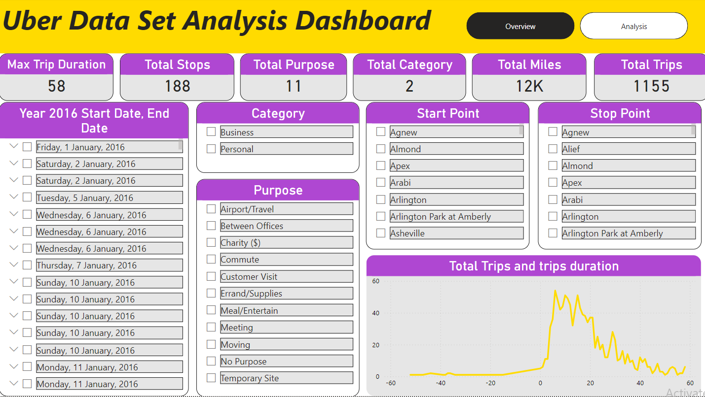

Slide 7
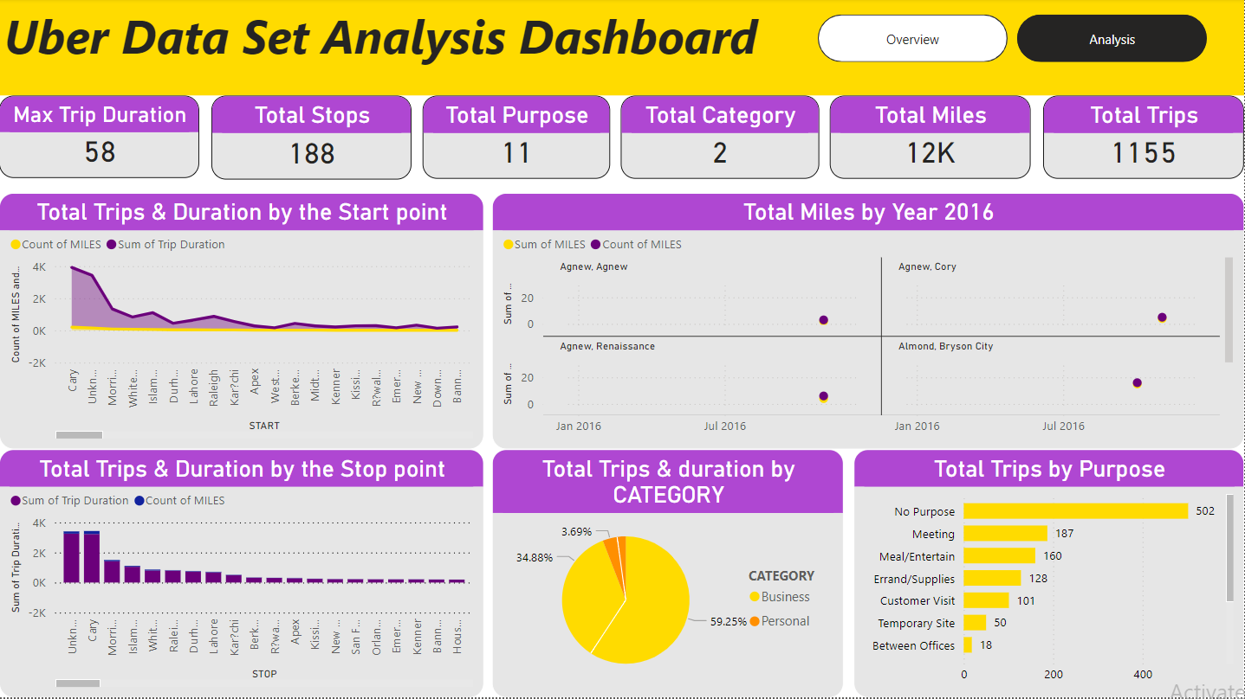

Slide 8

When the category is Business, te total trips are increased.
01
Key Insights
the rides within Year 2016 shows that we have more rides in the middle of the summer and at he end and the beginning of the year which seems normal for the events that always happening at that time. also when we see the total miles spent it’s in the both months of march and OCTOBER IT WAS AT THE PEAK. Also it appears that the trips on the weekend especially at Friday night are higher than any other day in the week.
02
03
Average duration for a trip is 17 mins and the max trip duration is 58 mins
while the start point may bigger in county cary it seem the peak for the end point is unknown locations
02
the total trips purpose is including within no purpose, and if we dive in the analysis we will see that all the purpose of the trips are within normal while with errand/supplies it starts to decrease.
04

Slide 9




Uneeq Intrens
THANK YOU!
Hala ElSebai
Data Analyst
01096328081
hala.elsebai98@gmail.com
Cairo,Egypt

